Slide 1
Presentation On Tableau PREP on Gender Gap Pay Presented by Janah Rajanesh (01-04-2022)

Slide 2
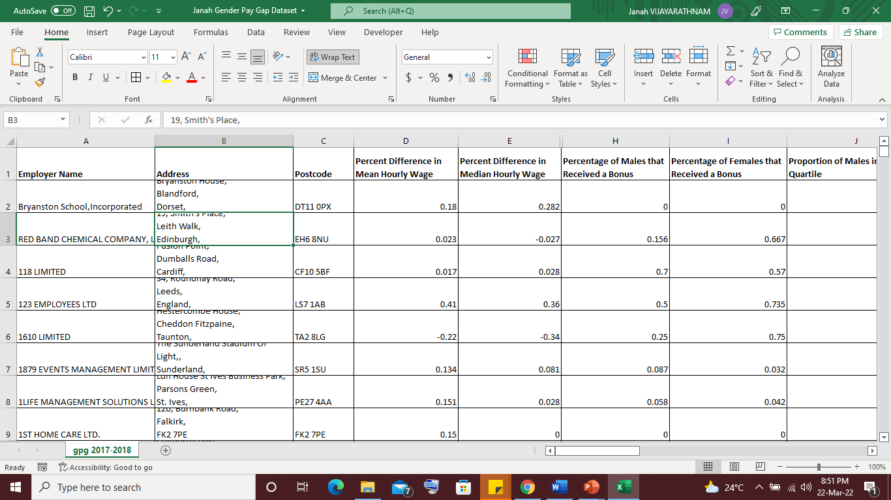
Dataset Gender Pay Gap
Gender Pay Gap - The gender wage gap is the difference between wages earned by men and wages earned by women. Data refer to full-time employees and to self-employed.

Slide 3
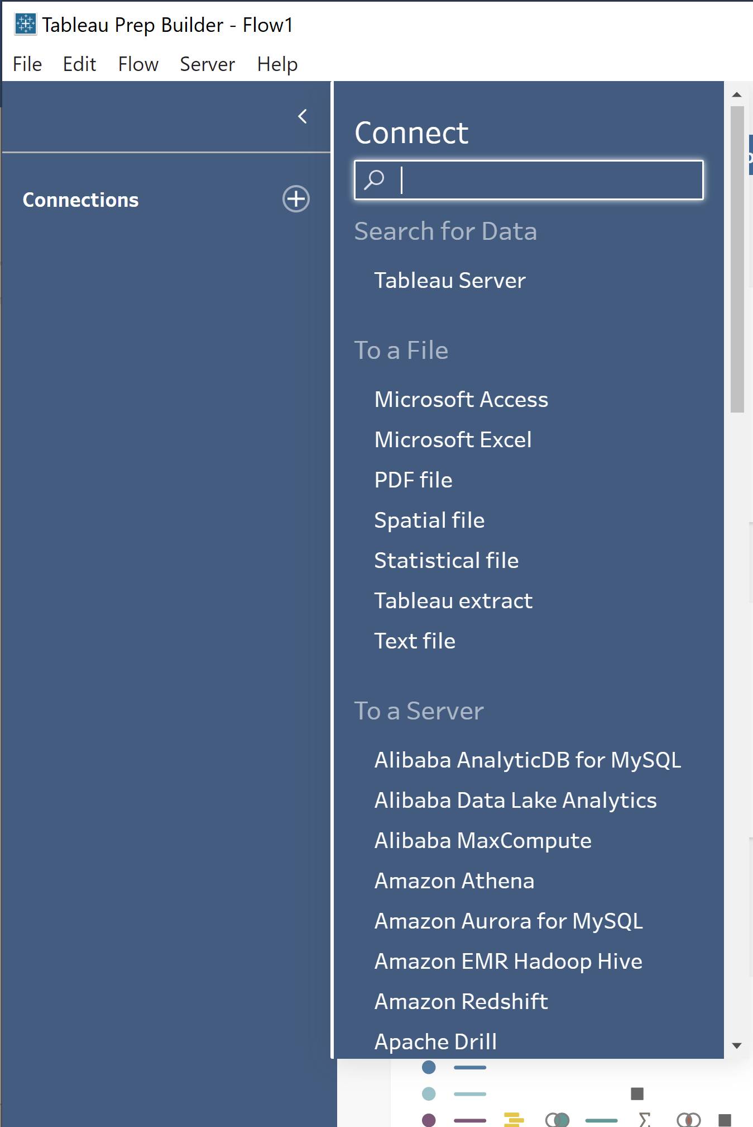
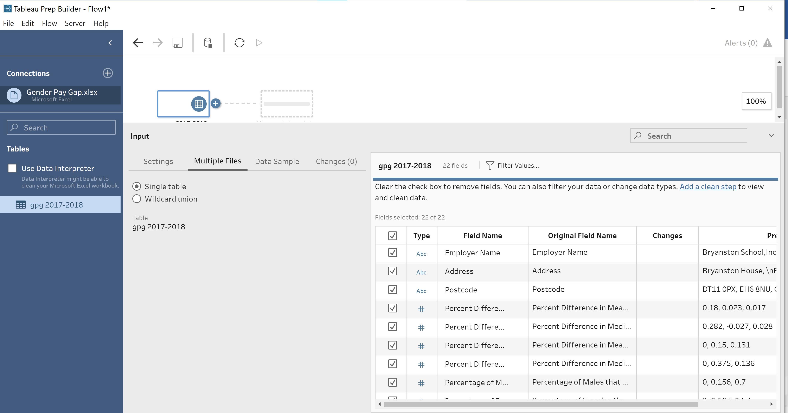
Step 1:Connecting to the data

Slide 4
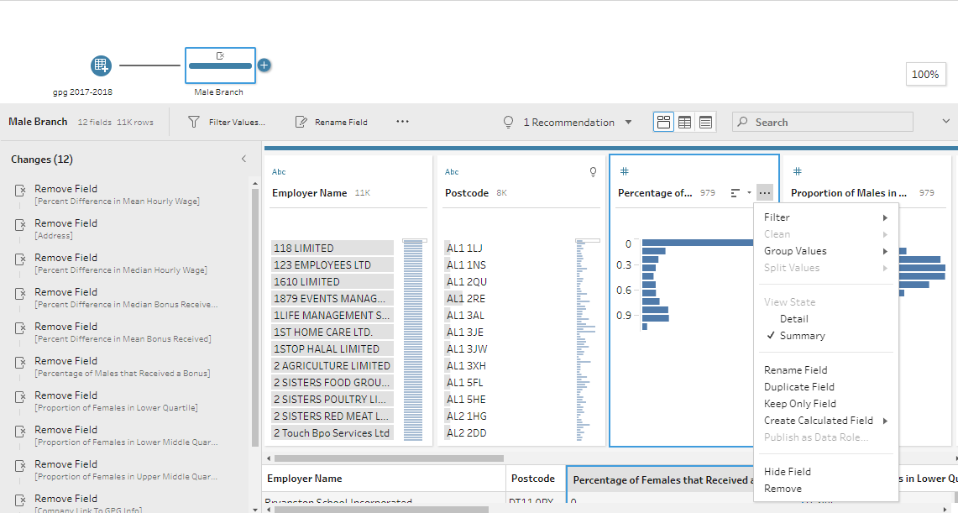
Step 2(Cleaning): Removing unwanted field
Here, I want to split this data into male and female, so now removing the female related columns.

Slide 5
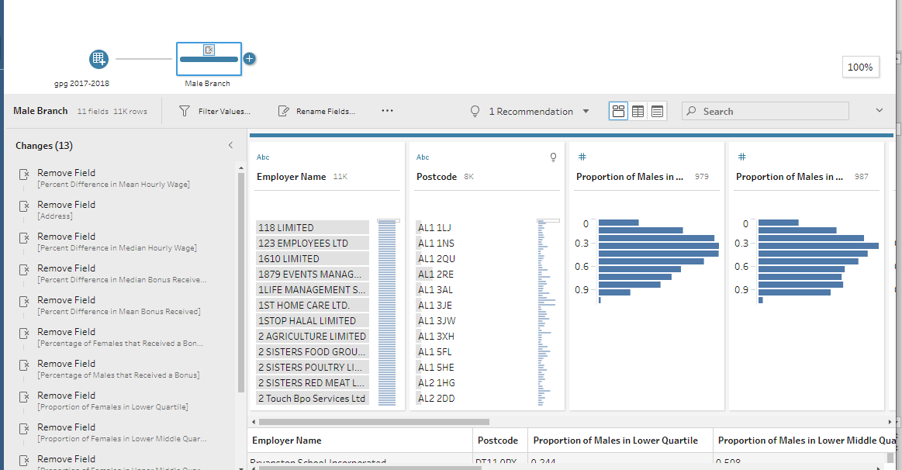
Rename columns and create new Column
View after removing 13 female pay related columns and changing name as Male branch for better understanding.

Slide 6
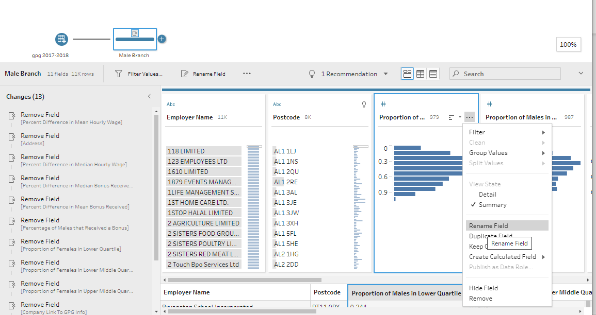
Renaming the required fields

Slide 7
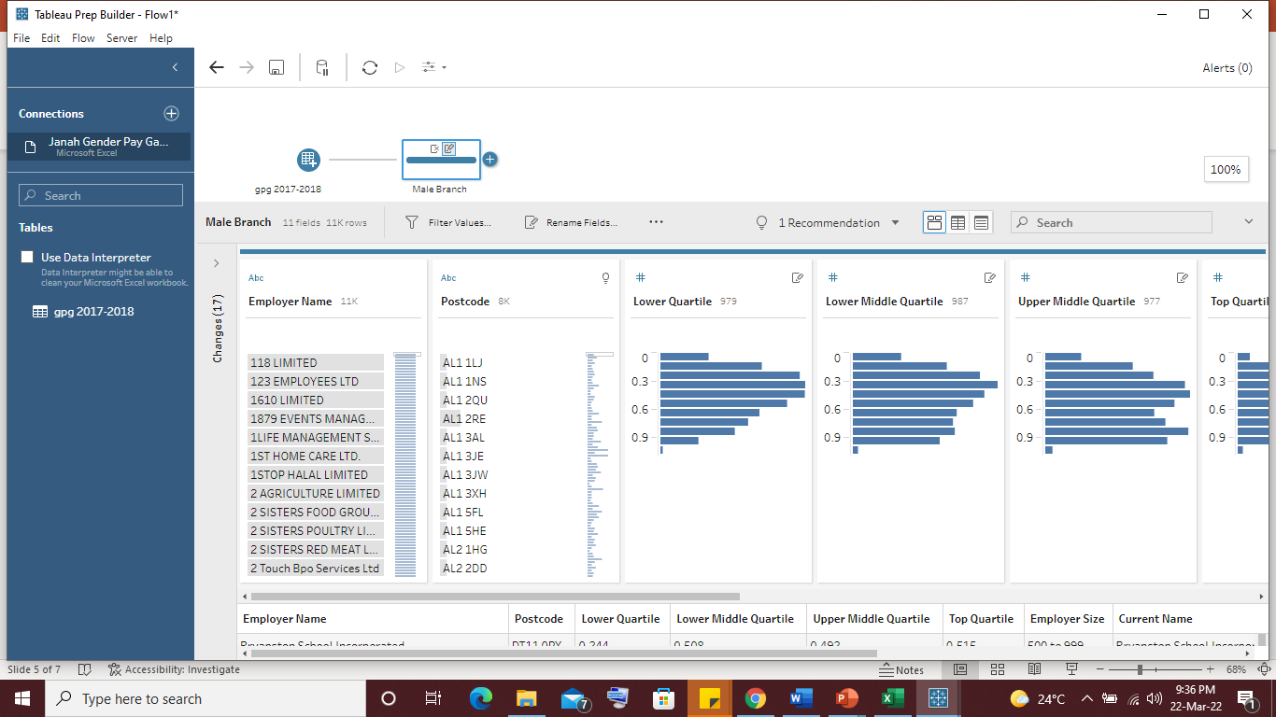
Contd.
This is view after renaming male columns

Slide 8
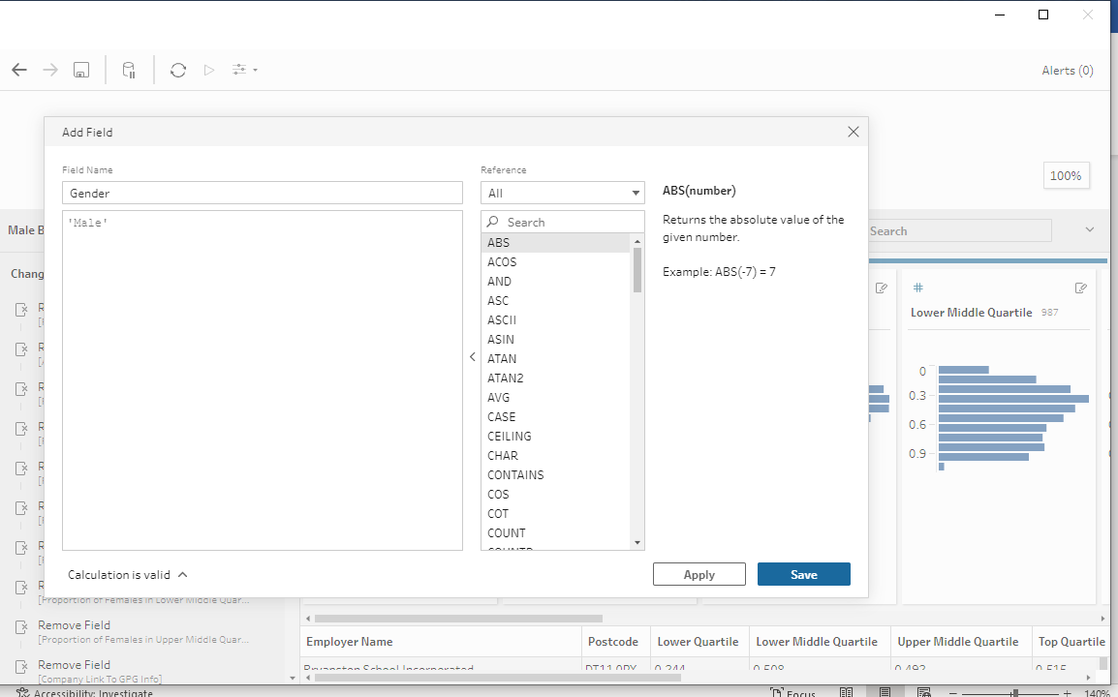
Creating new column
Creating gender- male column

Slide 9
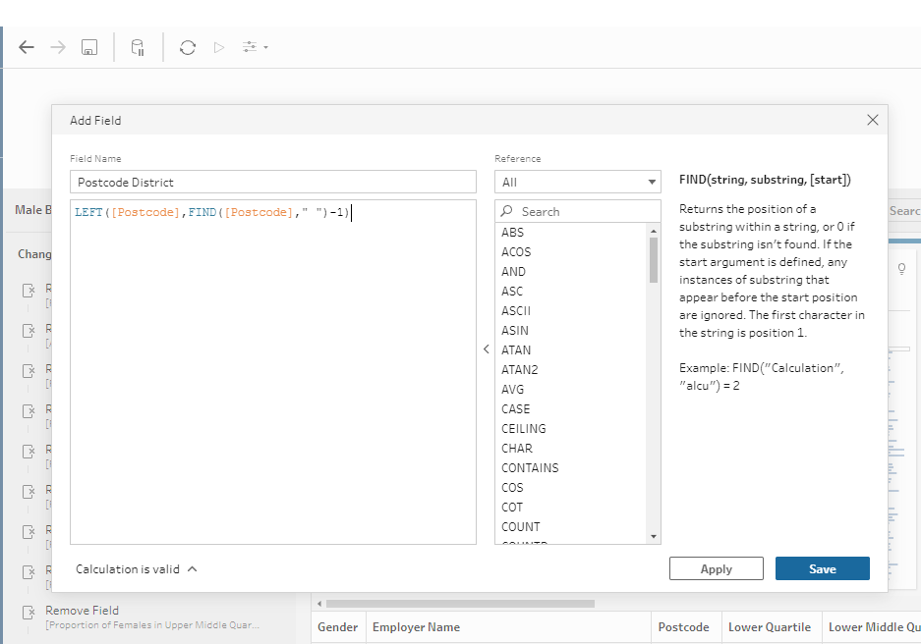
Create new ‘postcode district’ column
Here, I am creating another column ‘postcode district’ by taking part data from existing ‘postcode’ column

Slide 10
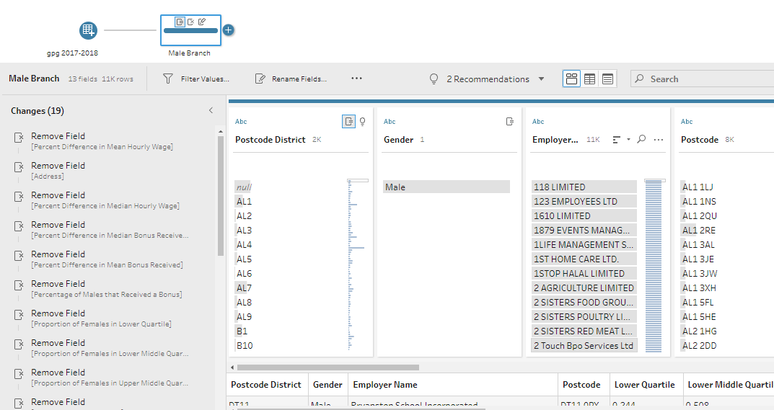
Contd.
View of new columns created, ‘gender: male’ and calculated ‘postcode district’ created.

Slide 11
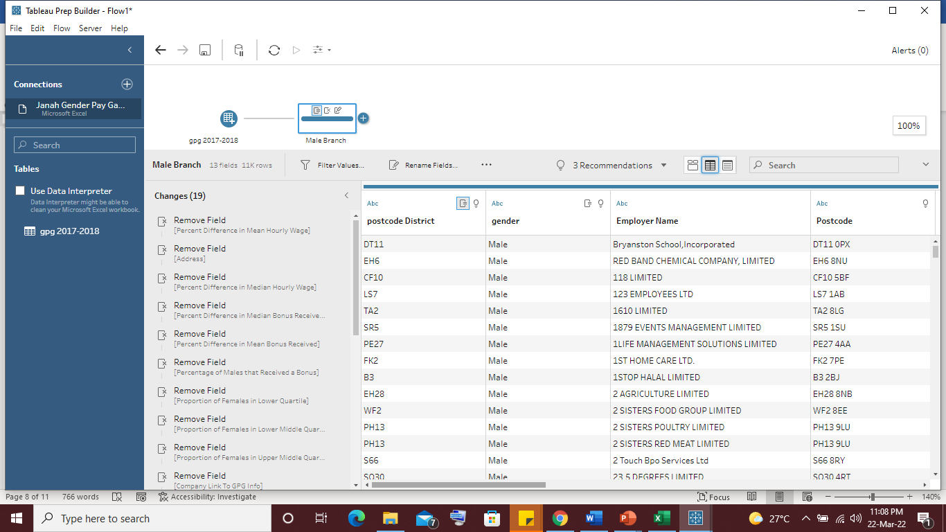
Grid view

Slide 12
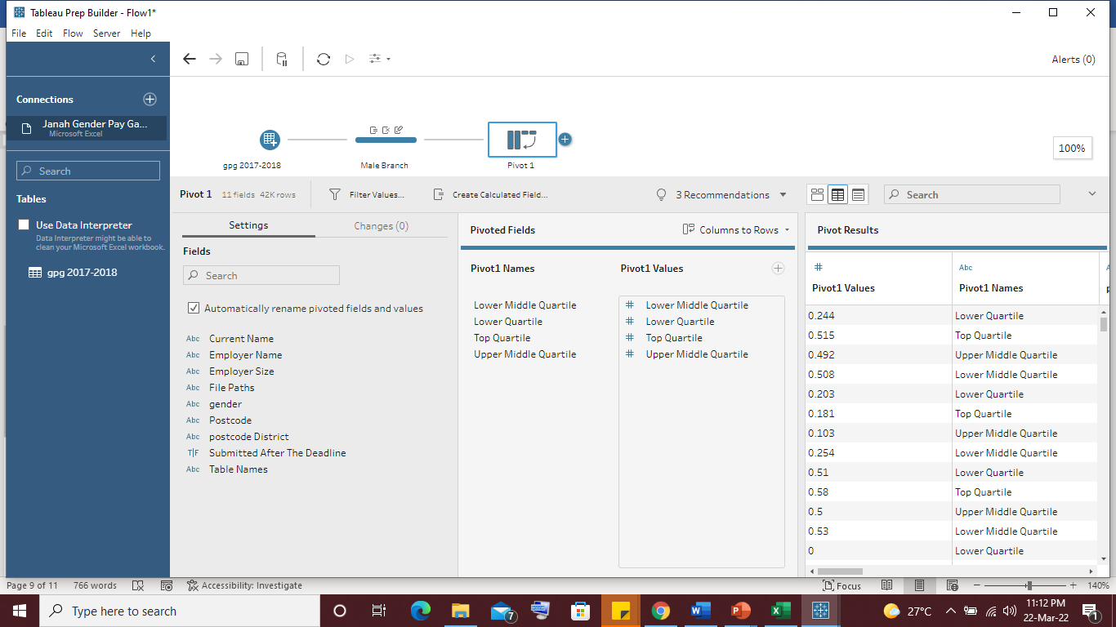
Creating pivot table
Here, I created pivot table and selected the required columns.
Pivot table allows grouping by any field (column)

Slide 13
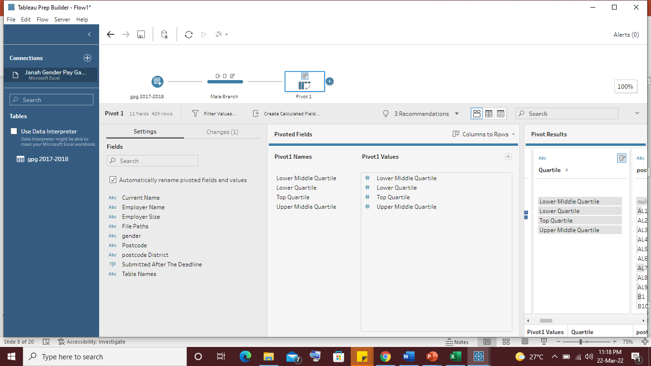
Rename pivot table

Slide 14

Female: Removing unwanted fields(male) and renaming the columns

Slide 15
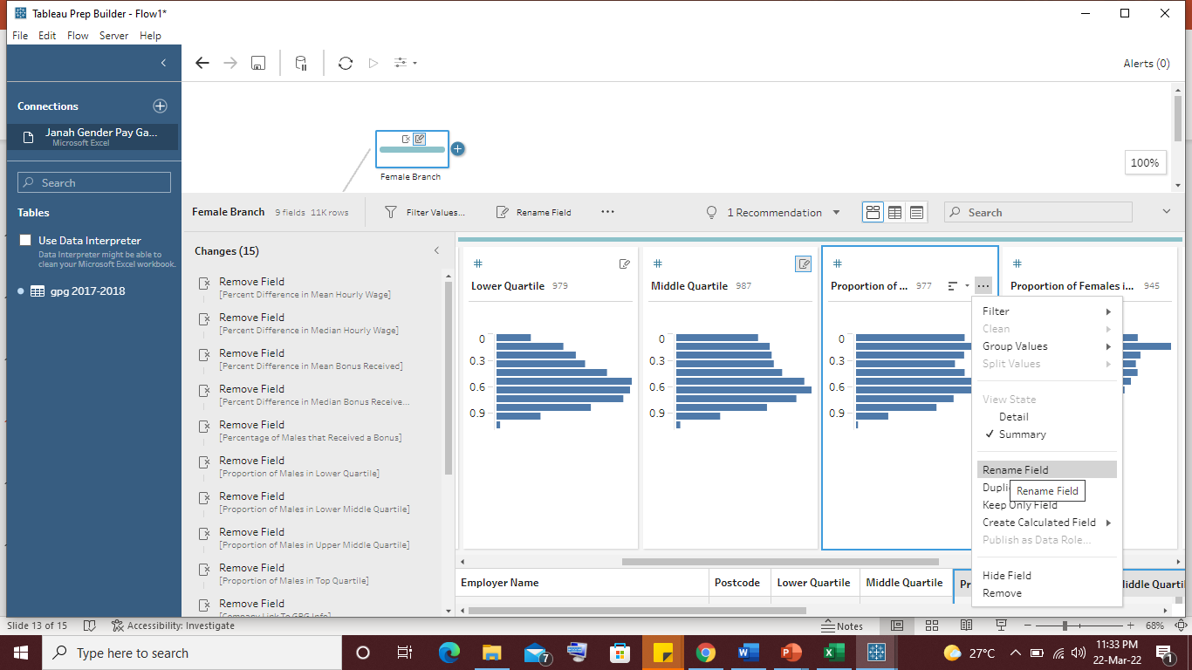
Contd.

Slide 16
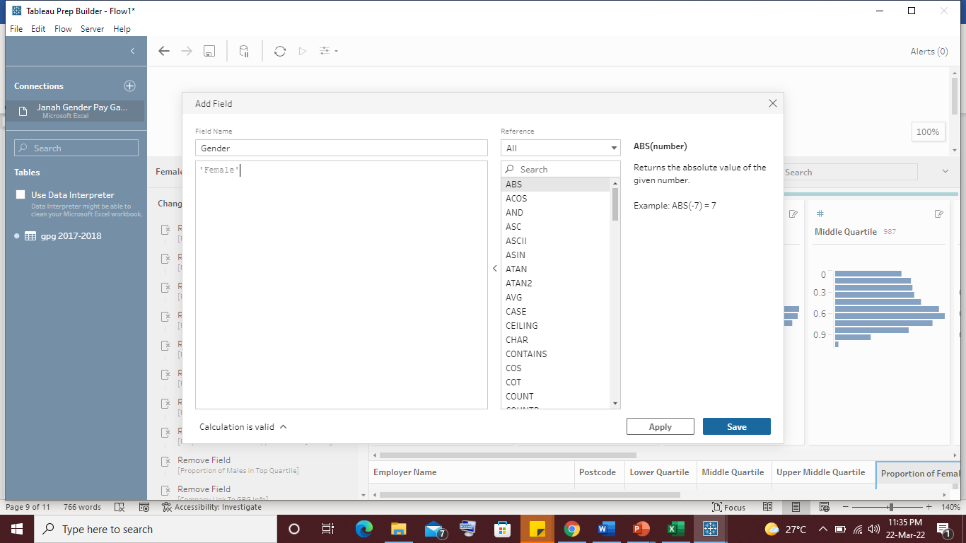
Create Gender- female column

Slide 17
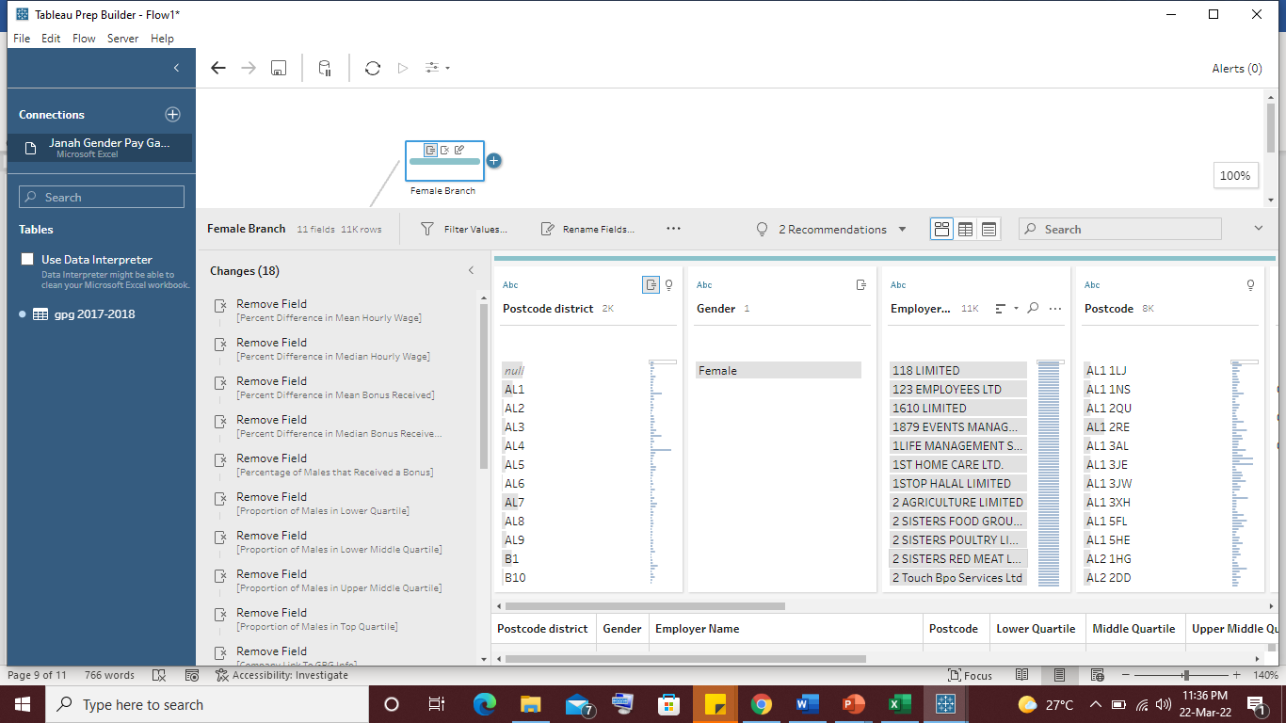
Create ‘postcode district’ new column(Female)

Slide 18
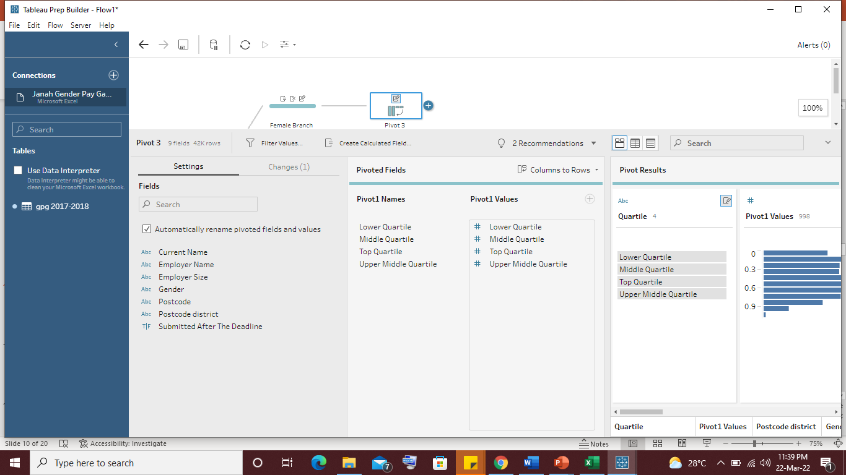
Create pivot table(Female)

Slide 19
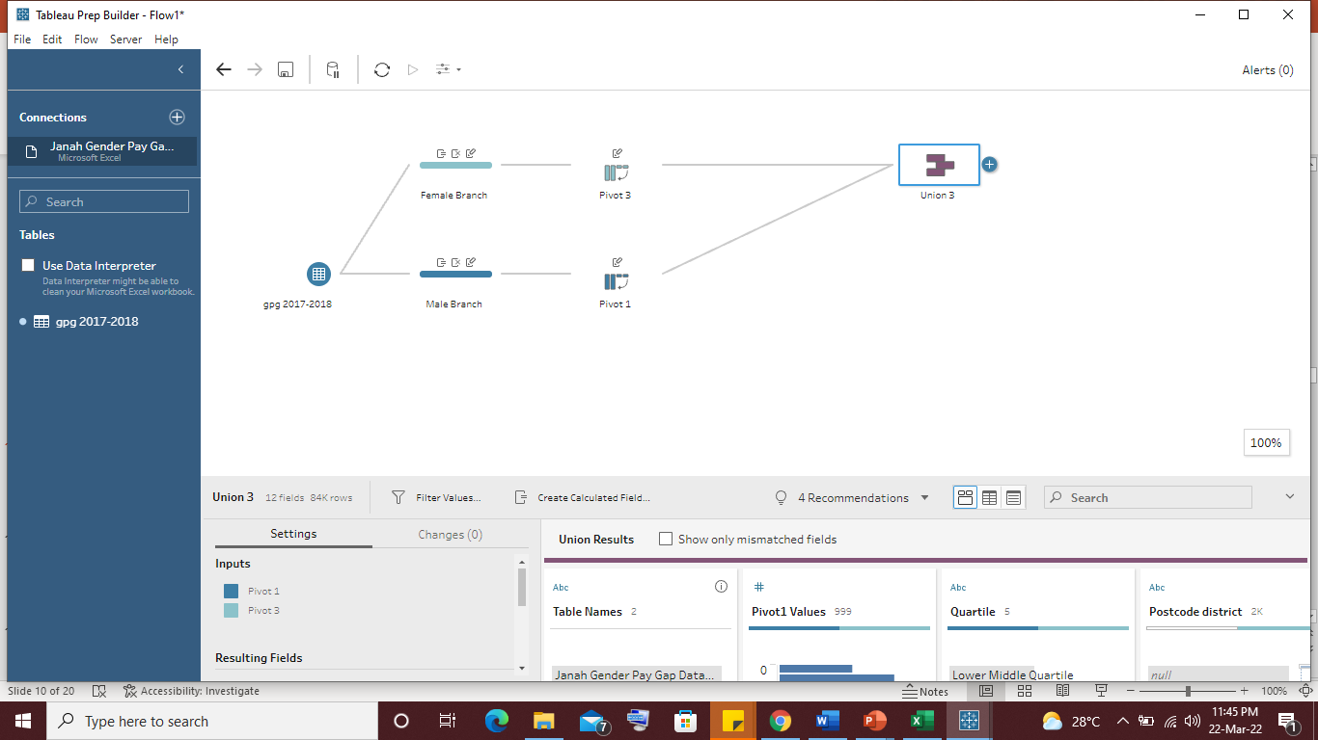
Creating union
Now we need to create a union between the Male and Female Pivot tables.
Now that we have completed the data processing, we can now export this data for visualization or any other purpose.

Slide 20
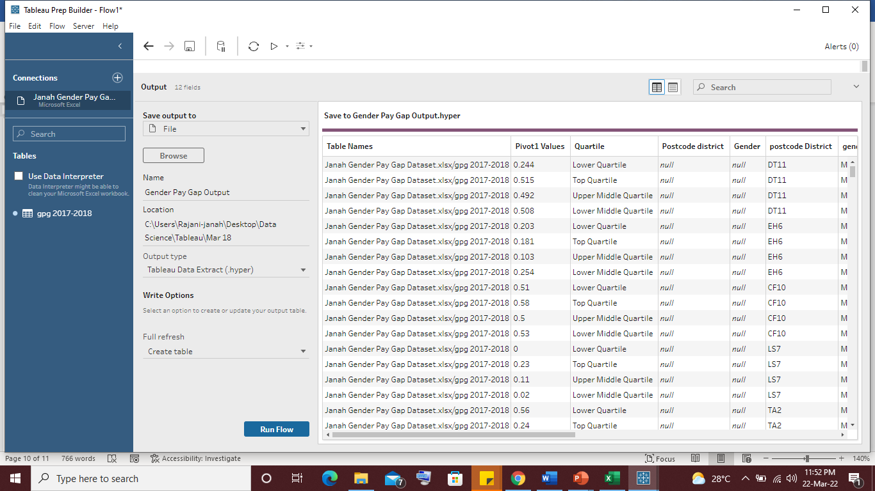
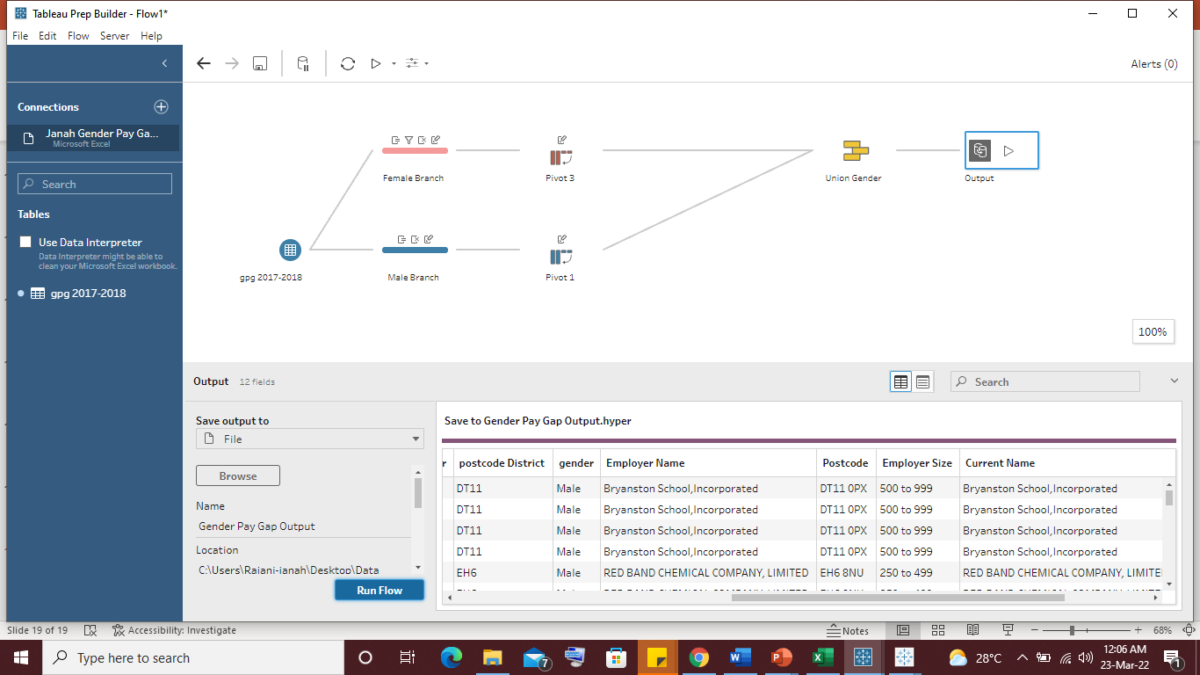
Output: complete workflow

Slide 21
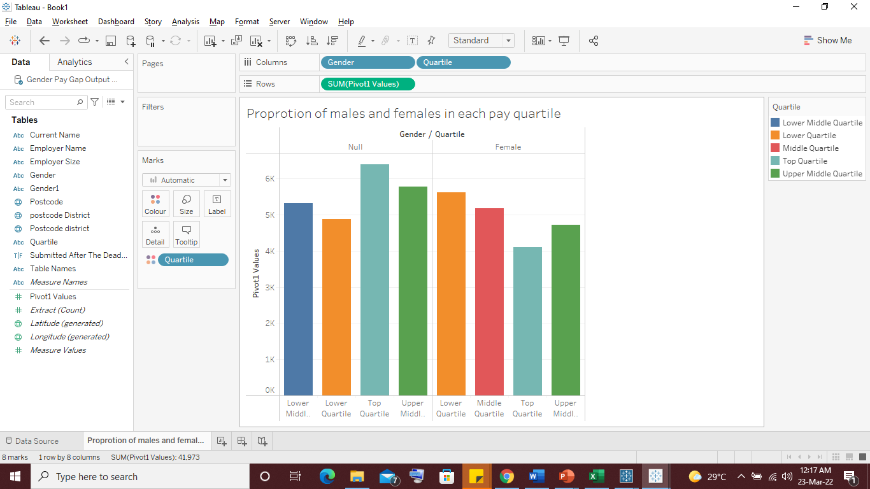

Proportion of male and female in each Quartile
The graph shows the avg value of male and female employees in each pay quartile for 10,508 companies in UK.
It is evident from the visualization that there are fewer female representation in the top pay scale.

Slide 22
Thank You

